Slide 1

How to increase the efficiency of pushing reviews on yelp?
——Personalized Recommendation System
application on reviews
Team10: Aryan Sehgal, Barrett Ratzlaff, Manyi Hong, Shreya Lodha

Slide 2


Our team is going to have coffee after class, but we don’t know which Cafe is good...

Slide 3

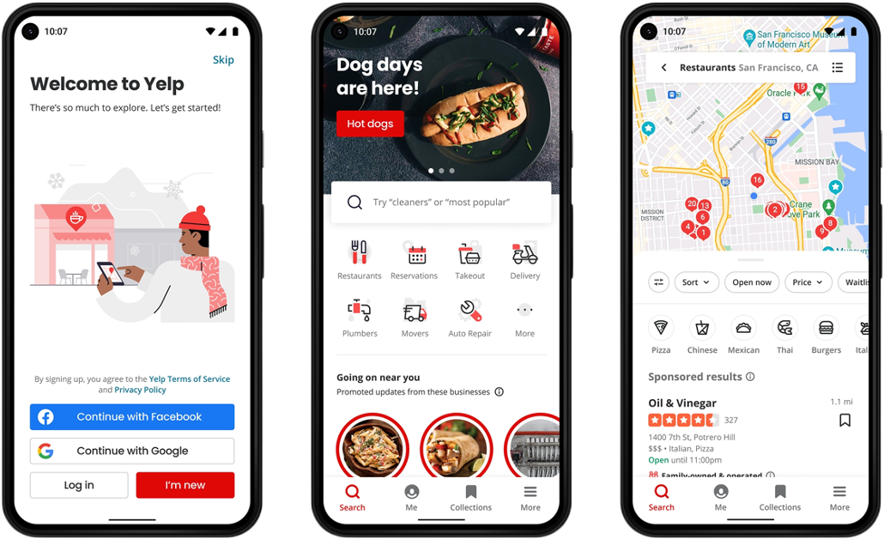

We logged into Yelp and started searching for our target cafe Dolce Vita Cafe

Slide 4
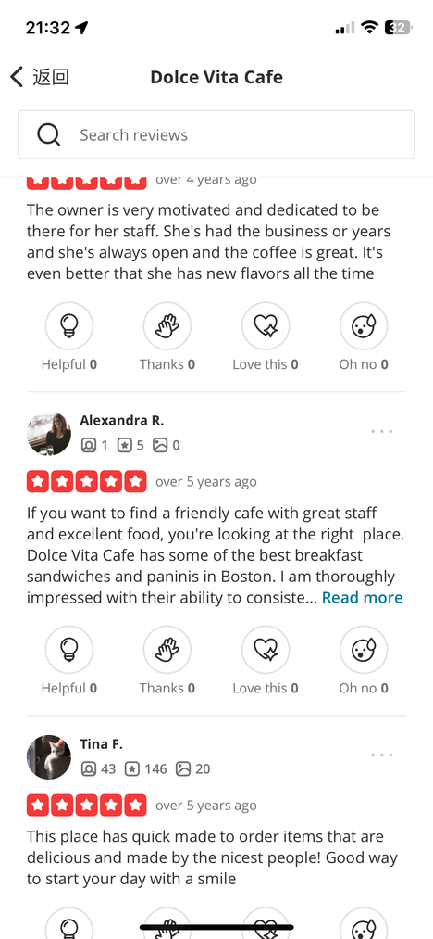
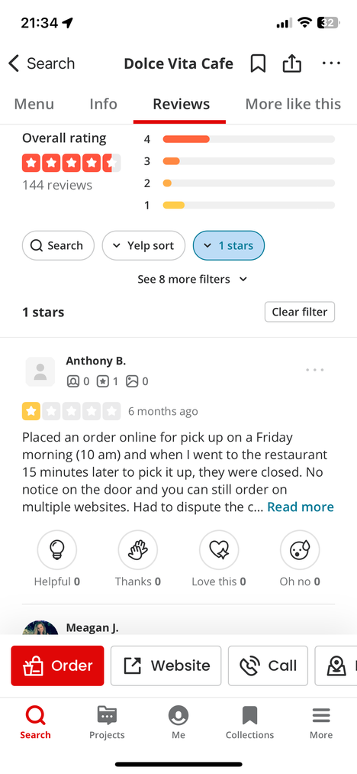
We tried to evaluate the shop’s issues by looking at negative reviews, we found it struggled to extract the key points we want
Too much reviews
No topic selection based on sentiment
Useless reviews
Over 200+ reviews
Horrible!

Slide 5
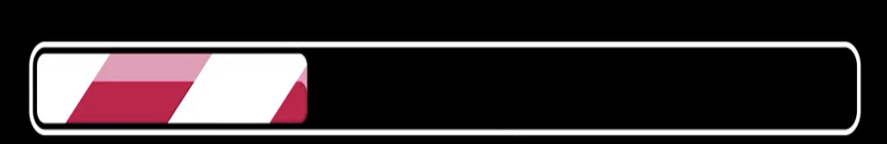
A Solution for Review Processing and Personalized Recommendations
System upgrading...

Slide 6
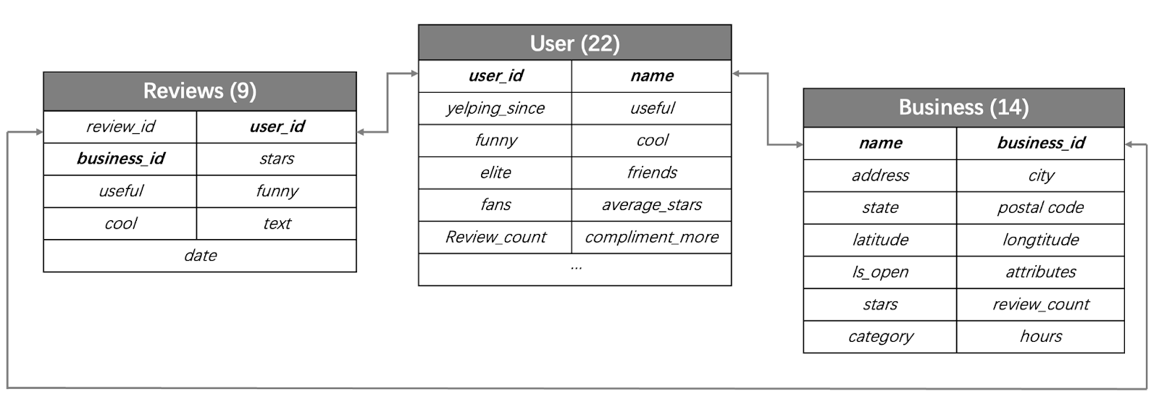
Data Source
Our dataset is offered publicly by Yelp, which provides real-world data related to businesses including reviews, photos, check-ins, and attributes like hours, parking availability, and ambiance.
focus on café businesses with 111,685 rows.
Source: https://business.yelp.com/data/resources/open-dataset/

Slide 7
Problem Statement
Consumers rely heavily on online reviews to make informed decisions about businesses, yet the overwhelming volume of reviews on Yelp often presents challenges that hinder user satisfaction and decision-making
GOALS
Problems
01
Categorize the reviews into key topics
01 Non-Thematically Categorized Reviews
It can be hard to align reviews with users' preferences, like providing food reviews for users who care about the service.
02 An overwhelming number of unhelpful reviews
It can be difficult to distinguish genuine reviews from unhelpful reviews or find an insightful review within a volume of reviews.
02
Analyze the sentiment of each review
03
Personalized recommendation system
2
Notes:
Insights
Seasonal Trends: Summer has the highest daily rentals (11,479), followed by autumn (9,666) and spring (9,625). Winter has the lowest (5,401), likely due to colder weather discouraging biking.
Weekday vs. Weekend: Weekends see higher daily rentals (9,788) compared to weekdays (8,979), likely driven by leisure activities.
Holidays vs. Non-Holidays: Non-holidays have slightly higher rentals than holidays, as holidays encourage longer trips by car, while bikes are preferred for shorter, local trips.
Time of Day: Afternoon (3,547) and evening (3,513) have the highest rentals, while morning (1,926) is lower, and late night (225) is the lowest.

Slide 8
Processing Map
TweetTokenizer
Compare result
Data preprocessing
Stopword
LDA
EDA
Text Mining
Clean
text
Topic Modeling
Punctuation
NMF
TfidfVectorizer
Personalized Recommendation System
KNN Classification
positive
Sentiment
Analysis
Application
Aggregate
all functions
TextBlob Analysis
Logistic Regression
negative
Notes:
Insights
Seasonal Trends: Summer has the highest daily rentals (11,479), followed by autumn (9,666) and spring (9,625). Winter has the lowest (5,401), likely due to colder weather discouraging biking.
Weekday vs. Weekend: Weekends see higher daily rentals (9,788) compared to weekdays (8,979), likely driven by leisure activities.
Holidays vs. Non-Holidays: Non-holidays have slightly higher rentals than holidays, as holidays encourage longer trips by car, while bikes are preferred for shorter, local trips.
Time of Day: Afternoon (3,547) and evening (3,513) have the highest rentals, while morning (1,926) is lower, and late night (225) is the lowest.

Slide 9
01 Pre-processing data
02 Text Mining
03 Topic Modeling
04 Sentiment Analysis
05 Personalized Recommendation
After experimenting, we found that TweetTokenizer worked best with our data.
A significant portion of the review data was written casually and in a similar way to posts on social media platform.
A significant portion of the data was also in other languages. For simplicity’s sake, we filtered our text through the English language.
Lastly, we removed stop words to refine our topic modeling.
Notes:
Insights
Seasonal Trends: Summer has the highest daily rentals (11,479), followed by autumn (9,666) and spring (9,625). Winter has the lowest (5,401), likely due to colder weather discouraging biking.
Weekday vs. Weekend: Weekends see higher daily rentals (9,788) compared to weekdays (8,979), likely driven by leisure activities.
Holidays vs. Non-Holidays: Non-holidays have slightly higher rentals than holidays, as holidays encourage longer trips by car, while bikes are preferred for shorter, local trips.
Time of Day: Afternoon (3,547) and evening (3,513) have the highest rentals, while morning (1,926) is lower, and late night (225) is the lowest.

Slide 10
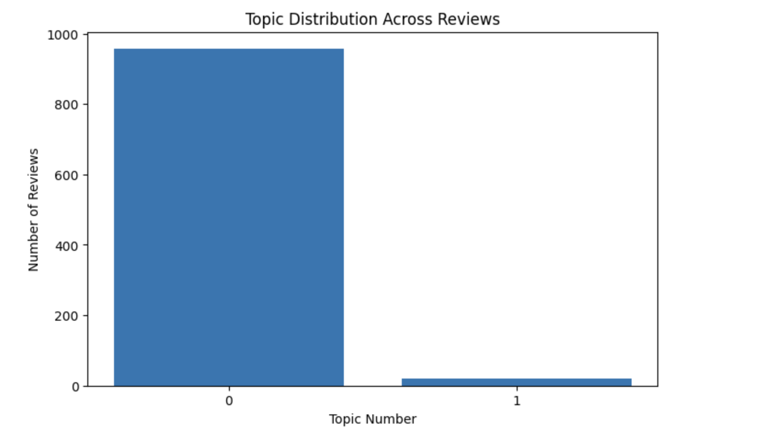
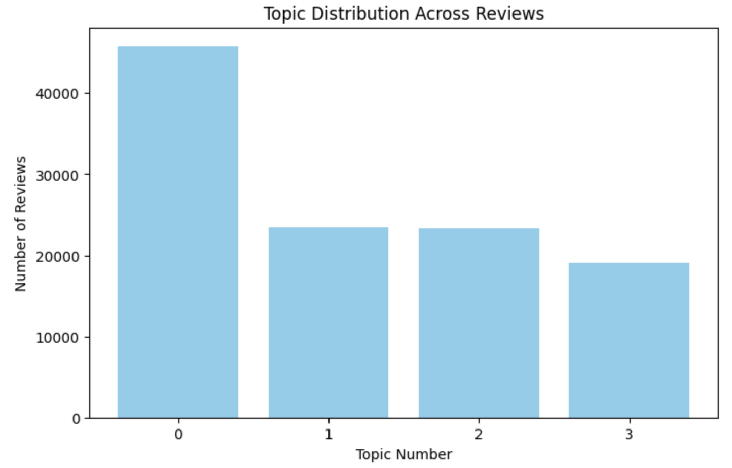
01 Pre-processing data
02 Text Mining
03 Topic Modeling
04 Sentiment Analysis
05 Personalized Recommendation
When applying LDA (pictured left), a problem we ran into is the distribution of topics amongst our bodies of reviews.
There was also difficulty interpreting the topics that LDA determined.
It was at this point that we pivoted to NMF (pictured right), which had more success in setting topics.
Notes:
Insights
Seasonal Trends: Summer has the highest daily rentals (11,479), followed by autumn (9,666) and spring (9,625). Winter has the lowest (5,401), likely due to colder weather discouraging biking.
Weekday vs. Weekend: Weekends see higher daily rentals (9,788) compared to weekdays (8,979), likely driven by leisure activities.
Holidays vs. Non-Holidays: Non-holidays have slightly higher rentals than holidays, as holidays encourage longer trips by car, while bikes are preferred for shorter, local trips.
Time of Day: Afternoon (3,547) and evening (3,513) have the highest rentals, while morning (1,926) is lower, and late night (225) is the lowest.

Slide 11
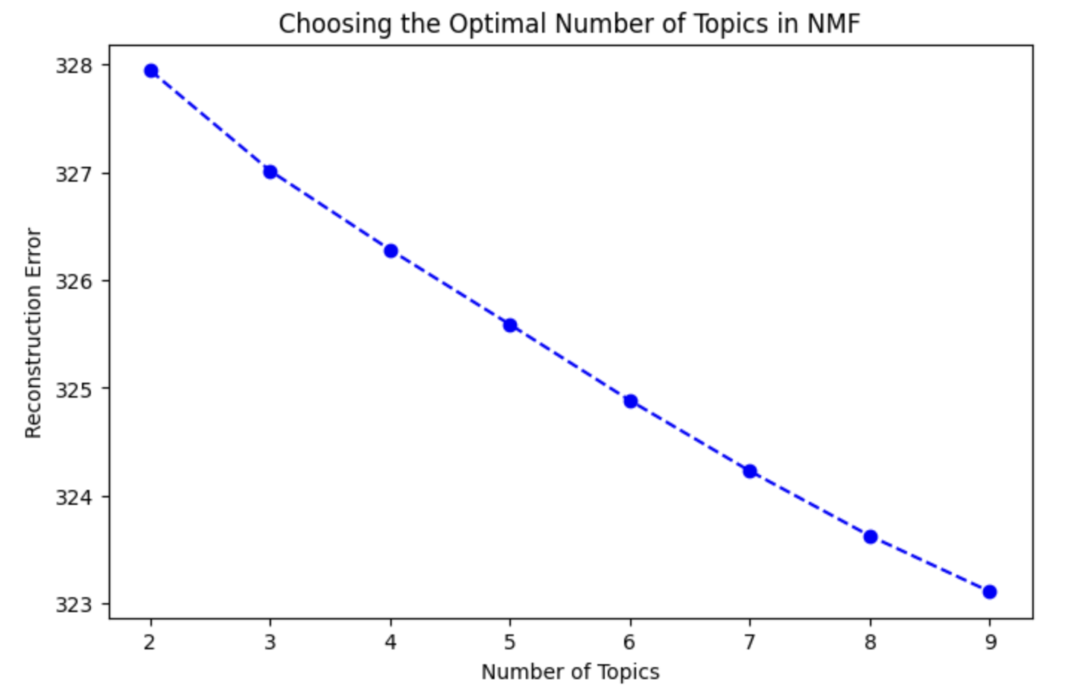
01 Pre-processing data
02 Text Mining
03 Topic Modeling
04 Sentiment Analysis
05 Personalized Recommendation
When selecting the number of topics to categorize, we wanted to balance minimizing reconstruction error and a practical number of categories for a group of reviews.
We settled on four since the difference in reconstruction error seems small between categories.
Notes:
Insights
Seasonal Trends: Summer has the highest daily rentals (11,479), followed by autumn (9,666) and spring (9,625). Winter has the lowest (5,401), likely due to colder weather discouraging biking.
Weekday vs. Weekend: Weekends see higher daily rentals (9,788) compared to weekdays (8,979), likely driven by leisure activities.
Holidays vs. Non-Holidays: Non-holidays have slightly higher rentals than holidays, as holidays encourage longer trips by car, while bikes are preferred for shorter, local trips.
Time of Day: Afternoon (3,547) and evening (3,513) have the highest rentals, while morning (1,926) is lower, and late night (225) is the lowest.

Slide 12
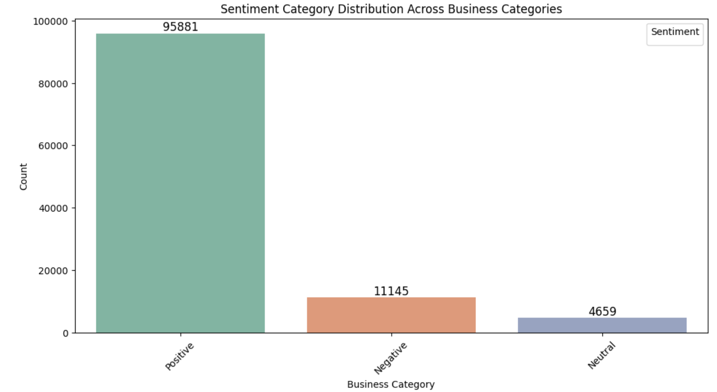
01 Pre-processing data
02 Text Mining
03 Topic Modeling
04 Sentiment Analysis
05 Personalized Recommendation
Our sentiment analysis process reflects the distribution of star reviews in our dataset.
To make our process more straightforward, we eliminated contradictory reviews (a positive review with < 3 stars, or vice versa).
Notes:
Insights
Seasonal Trends: Summer has the highest daily rentals (11,479), followed by autumn (9,666) and spring (9,625). Winter has the lowest (5,401), likely due to colder weather discouraging biking.
Weekday vs. Weekend: Weekends see higher daily rentals (9,788) compared to weekdays (8,979), likely driven by leisure activities.
Holidays vs. Non-Holidays: Non-holidays have slightly higher rentals than holidays, as holidays encourage longer trips by car, while bikes are preferred for shorter, local trips.
Time of Day: Afternoon (3,547) and evening (3,513) have the highest rentals, while morning (1,926) is lower, and late night (225) is the lowest.

Slide 13
01 Pre-processing data
02 Text Mining
03 Topic Modeling
04 Sentiment Analysis
05 Personalized Recommendation
Lastly, we synthesized our process into a function that can be applied at a business scale to present a relevant review.
The above process represents the steps of the functions.
The relevant review results were mixed.
Could perhaps be improved by adjusting our vectorization method to embeddings via Word2Vec.
The following slides show the function in action for a café, a tattoo parlor, and a casino hotel.
Notes:
Insights
Seasonal Trends: Summer has the highest daily rentals (11,479), followed by autumn (9,666) and spring (9,625). Winter has the lowest (5,401), likely due to colder weather discouraging biking.
Weekday vs. Weekend: Weekends see higher daily rentals (9,788) compared to weekdays (8,979), likely driven by leisure activities.
Holidays vs. Non-Holidays: Non-holidays have slightly higher rentals than holidays, as holidays encourage longer trips by car, while bikes are preferred for shorter, local trips.
Time of Day: Afternoon (3,547) and evening (3,513) have the highest rentals, while morning (1,926) is lower, and late night (225) is the lowest.

Slide 14
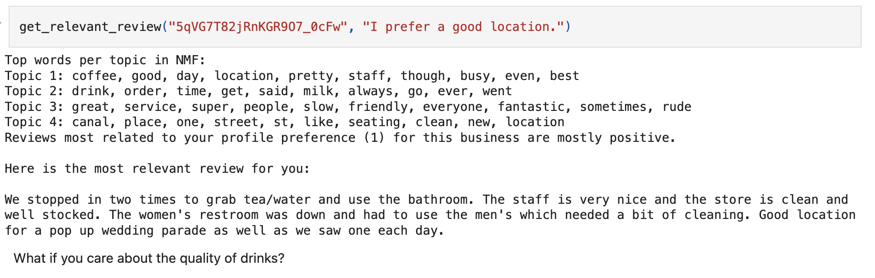
01 Pre-processing data
02 Text Mining
03 Topic Modeling
04 Sentiment Analysis
05 Personalized Recommendation
Café demonstration
Notes:
Insights
Seasonal Trends: Summer has the highest daily rentals (11,479), followed by autumn (9,666) and spring (9,625). Winter has the lowest (5,401), likely due to colder weather discouraging biking.
Weekday vs. Weekend: Weekends see higher daily rentals (9,788) compared to weekdays (8,979), likely driven by leisure activities.
Holidays vs. Non-Holidays: Non-holidays have slightly higher rentals than holidays, as holidays encourage longer trips by car, while bikes are preferred for shorter, local trips.
Time of Day: Afternoon (3,547) and evening (3,513) have the highest rentals, while morning (1,926) is lower, and late night (225) is the lowest.

Slide 15
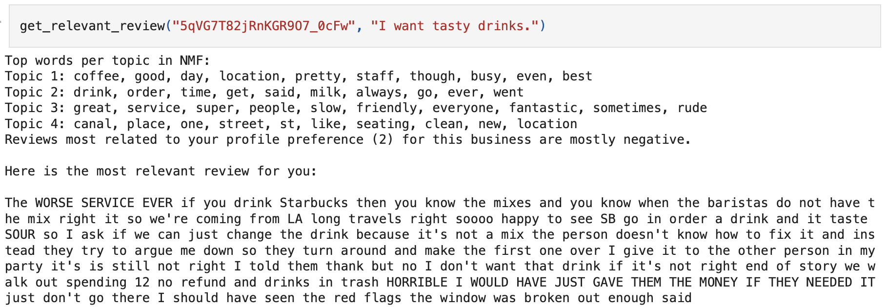

01 Pre-processing data
02 Text Mining
03 Topic Modeling
04 Sentiment Analysis
05 Personalized Recommendation
Café demonstration
Notes:
Insights
Seasonal Trends: Summer has the highest daily rentals (11,479), followed by autumn (9,666) and spring (9,625). Winter has the lowest (5,401), likely due to colder weather discouraging biking.
Weekday vs. Weekend: Weekends see higher daily rentals (9,788) compared to weekdays (8,979), likely driven by leisure activities.
Holidays vs. Non-Holidays: Non-holidays have slightly higher rentals than holidays, as holidays encourage longer trips by car, while bikes are preferred for shorter, local trips.
Time of Day: Afternoon (3,547) and evening (3,513) have the highest rentals, while morning (1,926) is lower, and late night (225) is the lowest.

Slide 16
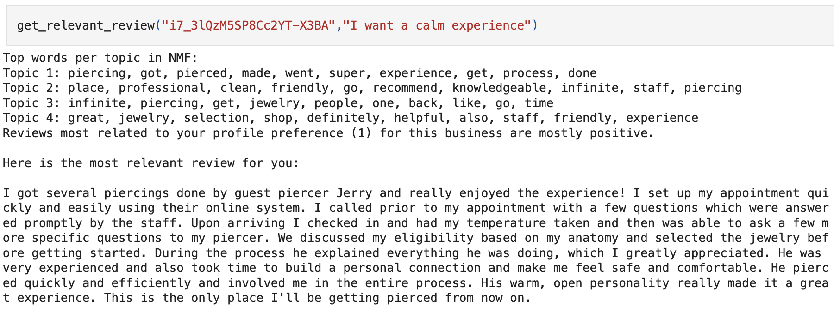

01 Pre-processing data
02 Text Mining
03 Topic Modeling
04 Sentiment Analysis
05 Personalized Recommendation
Tattoo Parlor demonstration
Notes:
Insights
Seasonal Trends: Summer has the highest daily rentals (11,479), followed by autumn (9,666) and spring (9,625). Winter has the lowest (5,401), likely due to colder weather discouraging biking.
Weekday vs. Weekend: Weekends see higher daily rentals (9,788) compared to weekdays (8,979), likely driven by leisure activities.
Holidays vs. Non-Holidays: Non-holidays have slightly higher rentals than holidays, as holidays encourage longer trips by car, while bikes are preferred for shorter, local trips.
Time of Day: Afternoon (3,547) and evening (3,513) have the highest rentals, while morning (1,926) is lower, and late night (225) is the lowest.

Slide 17
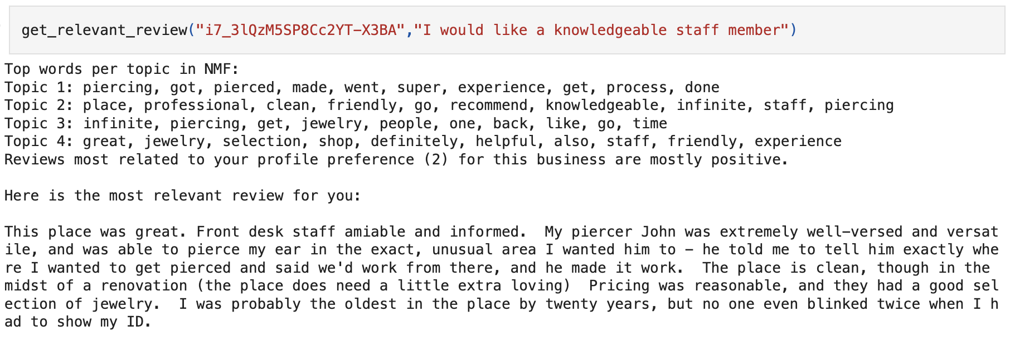
01 Pre-processing data
02 Text Mining
03 Topic Modeling
04 Sentiment Analysis
05 Personalized Recommendation
Tattoo Parlor demonstration
Notes:
Insights
Seasonal Trends: Summer has the highest daily rentals (11,479), followed by autumn (9,666) and spring (9,625). Winter has the lowest (5,401), likely due to colder weather discouraging biking.
Weekday vs. Weekend: Weekends see higher daily rentals (9,788) compared to weekdays (8,979), likely driven by leisure activities.
Holidays vs. Non-Holidays: Non-holidays have slightly higher rentals than holidays, as holidays encourage longer trips by car, while bikes are preferred for shorter, local trips.
Time of Day: Afternoon (3,547) and evening (3,513) have the highest rentals, while morning (1,926) is lower, and late night (225) is the lowest.

Slide 18
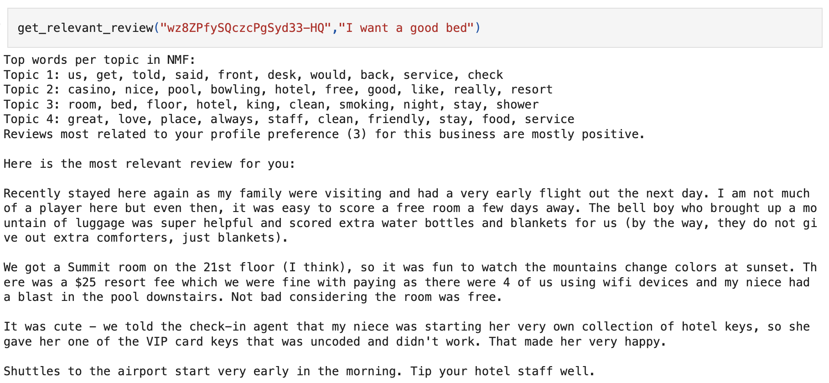
01 Pre-processing data
02 Text Mining
03 Topic Modeling
04 Sentiment Analysis
05 Personalized Recommendation
Hotel demonstration
Our results can be mixed when it comes to producing a relevant review.
Notes:
Insights
Seasonal Trends: Summer has the highest daily rentals (11,479), followed by autumn (9,666) and spring (9,625). Winter has the lowest (5,401), likely due to colder weather discouraging biking.
Weekday vs. Weekend: Weekends see higher daily rentals (9,788) compared to weekdays (8,979), likely driven by leisure activities.
Holidays vs. Non-Holidays: Non-holidays have slightly higher rentals than holidays, as holidays encourage longer trips by car, while bikes are preferred for shorter, local trips.
Time of Day: Afternoon (3,547) and evening (3,513) have the highest rentals, while morning (1,926) is lower, and late night (225) is the lowest.

Slide 19
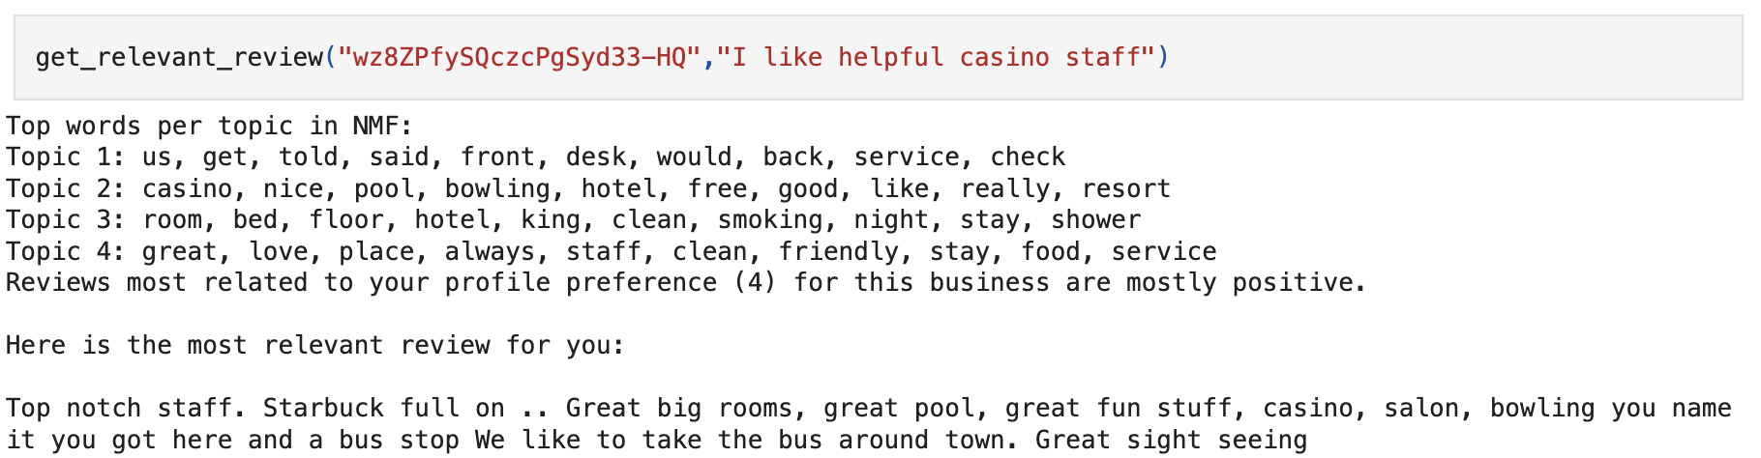
01 Pre-processing data
02 Text Mining
03 Topic Modeling
04 Sentiment Analysis
05 Personalized Recommendation
Hotel demonstration
Notes:
Insights
Seasonal Trends: Summer has the highest daily rentals (11,479), followed by autumn (9,666) and spring (9,625). Winter has the lowest (5,401), likely due to colder weather discouraging biking.
Weekday vs. Weekend: Weekends see higher daily rentals (9,788) compared to weekdays (8,979), likely driven by leisure activities.
Holidays vs. Non-Holidays: Non-holidays have slightly higher rentals than holidays, as holidays encourage longer trips by car, while bikes are preferred for shorter, local trips.
Time of Day: Afternoon (3,547) and evening (3,513) have the highest rentals, while morning (1,926) is lower, and late night (225) is the lowest.

Slide 20

A Solution for Review Processing and Personalized Recommendations
Upgraded successfully！

Slide 21

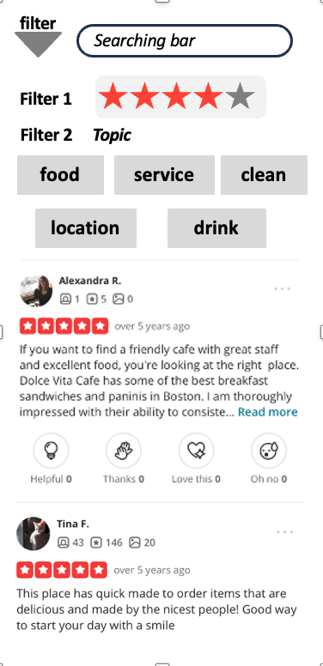

After optimizing the system, we finally find the reviews we're interested in about this cafe.
01 Reviews sorted by different categories
02 Recommend insightful reviews only

Slide 22

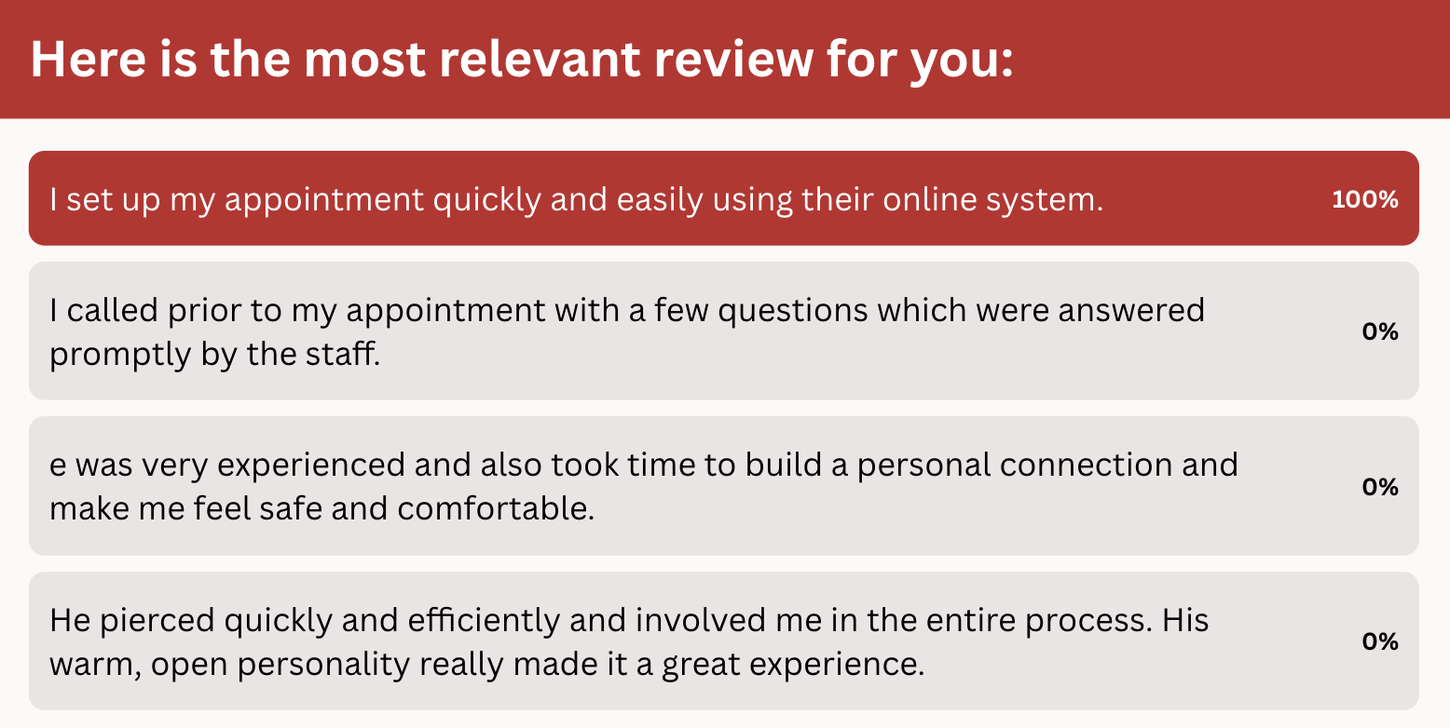
Besides that, we can also extract answers from the reviews by asking questions
I want a calm experience

Slide 23

Here we are !!!

Slide 24
Thank you!
Team10: Aryan Sehgal, Barrett Ratzlaff, Manyi Hong, Shreya Lodha

